Slide 1

Linear Algebra
Vectors, vector spaces, matrices,
coordinates, and transformations
Yordan Darakchiev
Technical Trainer
iordan93@gmail.com

Slide 2
Table of Contents
sli.do: #linalg
Vectors – geometric and algebraic perspective
  Operations
Matrices
  Definition, properties, operations
Linear transformations
Linear systems

Slide 3
Vectors
Concrete and abstract

Slide 4

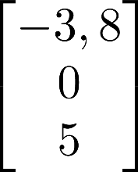
Vector Definitions
“Physics definition”
  A pointed segment in space
“Computer science definition”
  A list of objects (usually numbers)
  Dimensions = length
Math definition
  Encompasses both, and allows even more abstraction:
  Vectors can be added and multiplied
    By numbers and other vectors
  Similar to how we defined a field
Another perspective
  Transformations
  Actually, things a just a little more complicated…
    You can look up “tensors” if you’re interested
    We’ll talk a little about tensors later

Slide 5
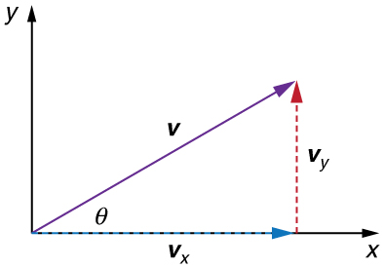

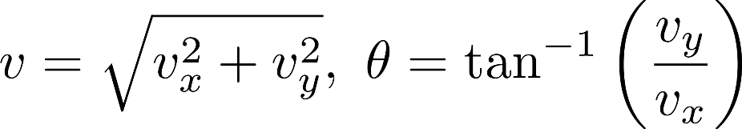
Vector Components
The distances to all coordinate axes:
Equivalent to
  Polar coordinates:
Finding components
  Pythagoras
Finding the polar form (magnitude, direction)
All these operations generalize to more than 2 dimensions
Note: We usually denote vectors by or with bold type:
  Another notation: Latin letters for vectors, Greek letters for numbers
  Reason: The vector and its length can be easily confused

Slide 6
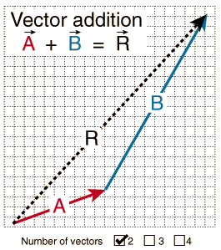
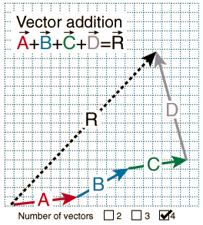
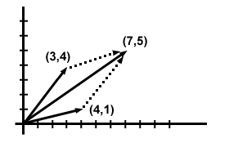
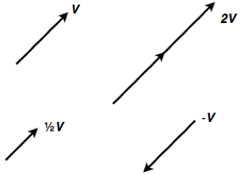
Vector Operations
Addition
  Result:
  length = distance from start to end,
  direction: start end
  In component form
    Sum all components for every direction
Multiplication by a number (scalar)
  Result:
  length = scaled length,
  direction: same (if scalar ), opposite otherwise
  In component form
    Multiply each component by the number

Slide 7
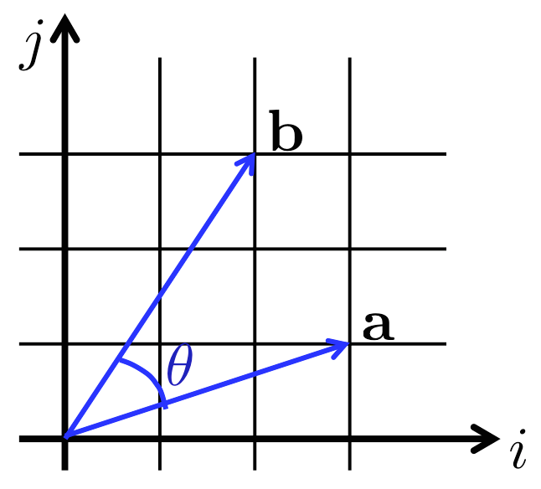

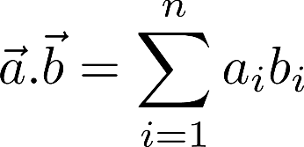
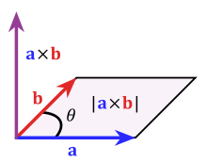

Vector Operations (2)
Scalar product of two vectors
  Also called dot product or inner product
  Result: scalar
  Definition:
  Using the vector components:
Vector product of two vectors
  Also called cross product
  Result: vector, perpendicular to both initial vectors
  Definition
    – normal vector
    Magnitude: = volume of parallelogram
    between and
    Direction: coincides with the direction of

Slide 8
Vector Spaces
Finding yourself in space

Slide 9





Vector Space
A field (usually or ):
A set of elements (vectors):
Operations
  Addition of two vectors:
  Multiplication by an element of the field:
A “checklist” of eight axioms
We read this as "vector space (or linear space) over the field "
Examples of vector spaces
  Coordinate space, e.g. real coordinate space
    -dimensional vectors
  Infinite coordinate space
    Vectors with infinitely many components
  Polynomial space
    All polynomials of variable with real coefficients
  Function space

Slide 10
Linear Combinations
Vectors
Numbers (scalars)
Linear combination
  The sum of each vector multiplied by a scalar coefficient
  Why linear? No fancy functions, no vector multiplications
Span (linear hull) of vectors: the set of all their linear combinations
Linear (in)dependence
  The vectors are linearly independent if the only solution to the equation
  is
  Conversely, they are linearly dependent if there is a non-trivial linear combination
  which is equal to zero
Example

Slide 11
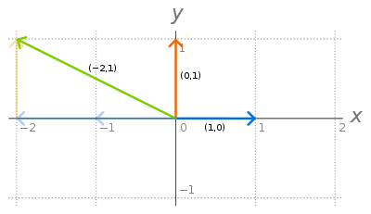
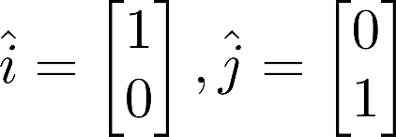
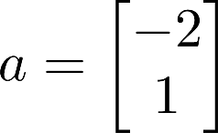

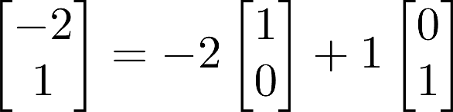
Basis Vectors
Consider
Now consider the vector
We can see that we can express as the
linear combination
Basis vectors
  Linearly independent
  Every other vector in the space can be represented as their linear combination
    This linear combination is unique
Each vector space has a basis
Each pair of two LI vectors forms a basis in 2D coordinate space
  More generally, each set of n LI vectors forms a basis in n-dimensional vector space

Slide 12

Matrices
Which pill are you going to take?

Slide 13
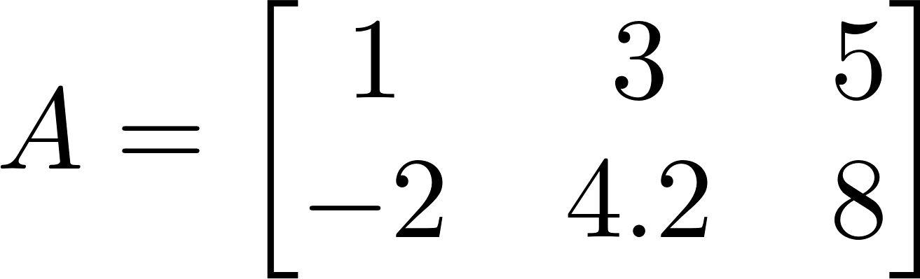
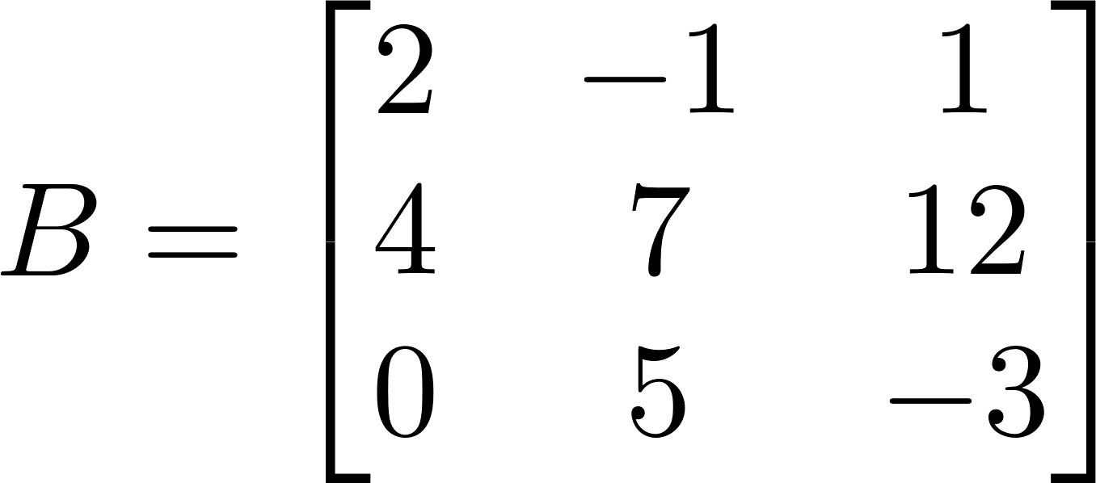
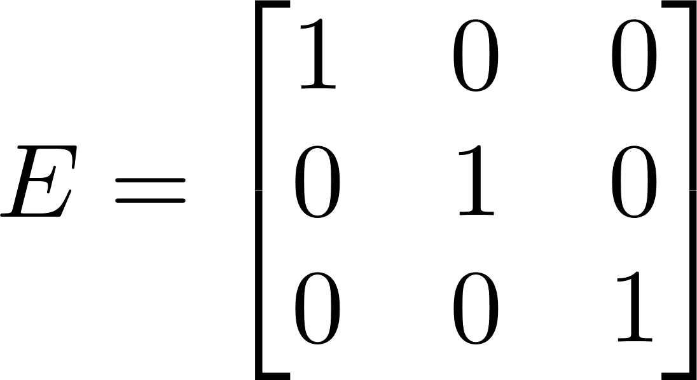
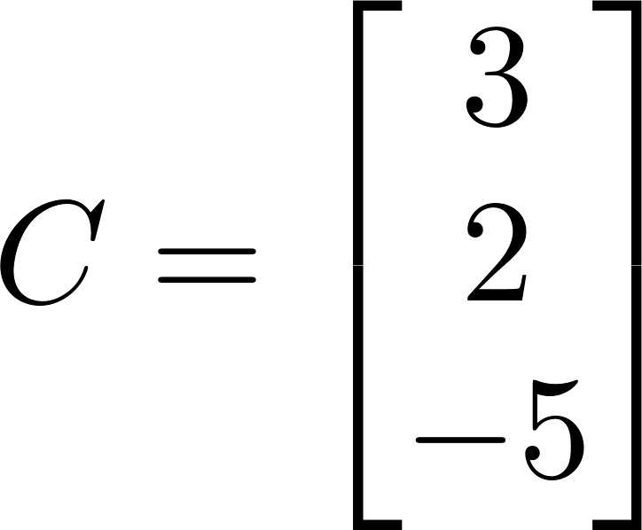
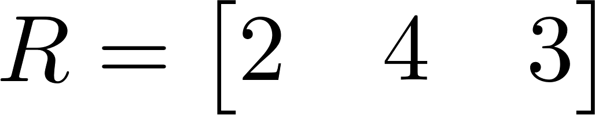
Matrix
A rectangular table of numbers
Dimensions: rows columns
  May also be infinite
Examples:
  – row vector, – column vector
Elements
Some thoughts about dimensions
  Scalars have no dimensions: 2; 3; 18; -42; 0,5
  Vectors have one dimension:
  Matrices have two dimensions:
  A generalization of this pattern to many dimensions is called a tensor
    Tensors are quite more complicated than this, but for almost all purposes it’s OK
    to think about them as multidimensional matrices

Slide 14
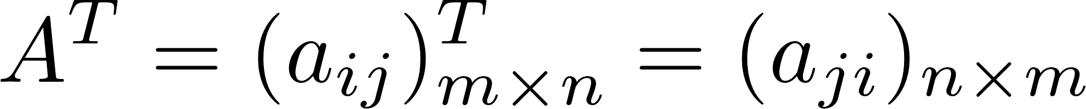
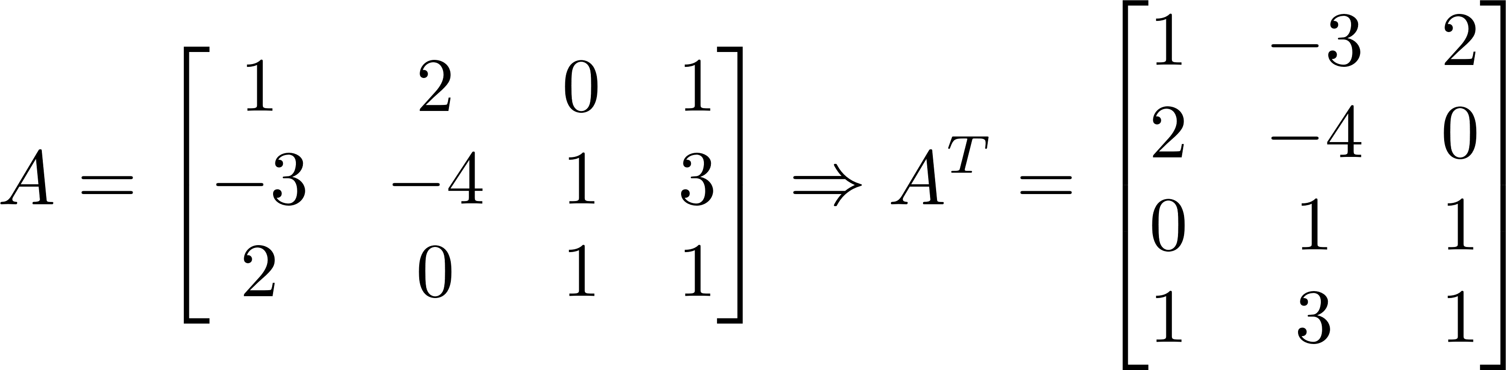
Matrix Operations
Addition (the dimensions must be the same)
Multiplication by a scalar
All matrices form a vector space
Transposition: turning rows into columns and vice versa
  The transpose of a matrix is denoted by an upper index T

Slide 15

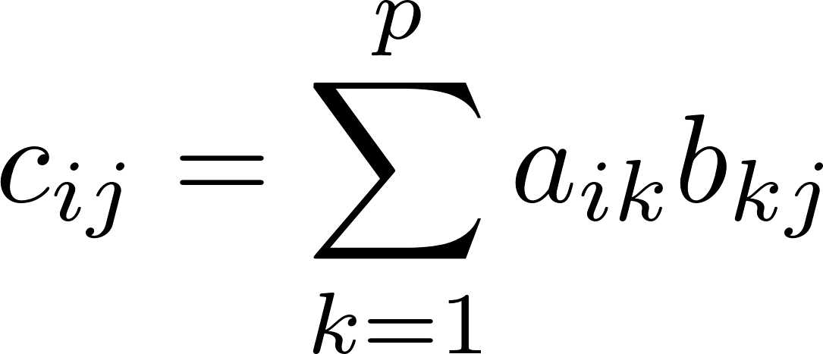
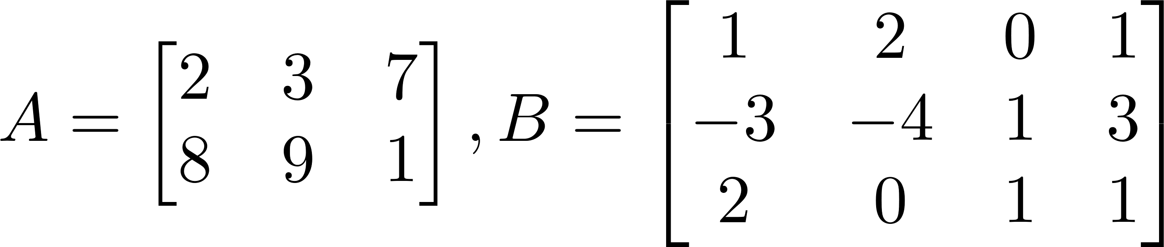
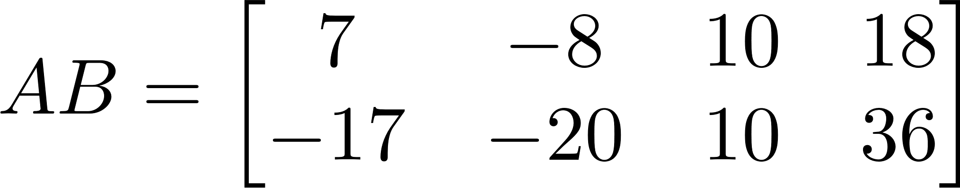
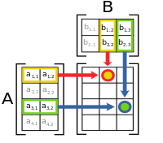
Matrix Multiplication
The dimensions must match:
  “Inner dimensions” are the same; result has “outer dimensions”
Definition:
Example
Note that
  In this case, we can’t even multiply
  We say that matrix multiplication is not commutative
    Compare with multiplication of numbers: 5.3 = 3.5 commutative

Slide 16
Matrix Operations in numpy
In numpy we can use dot() for matrix multiplication and dot products
Note: Whenever possible, use numpy arrays instead of Python lists
  They perform much faster
  They make the code a lot cleaner
A = np.array([
[2, 3, 7],
[8, 9, 1]
])
B = np.array([
[1, -3, 0],
[2, -4, 1]
])
print(A + B)
print(2 * A)
print(A * B) # Element-wise multiplication
print(A.dot(B)) # Error: incompatible dimensions
print(A.dot(B.T)) # Matrix multiplication

Slide 17
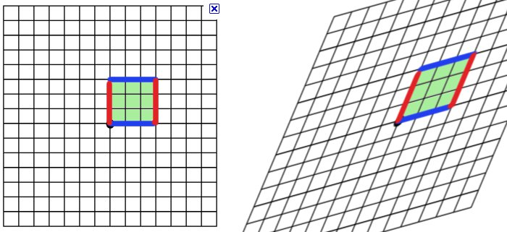
Linear Transformations
Transformation
  A mapping (function) between two vector spaces
  Special case: mapping a space onto itself:
    This is called a linear operator
  Each vector of gets mapped to a vector in
    Intuition: think about vectors as points
Linear
  Only linear combinations are allowed
  The origin remains fixed
  All lines remain lines (not curves)
  All lines remain evenly spaced (equidistant)
Each space has a basis
  All other vectors can be expressed as linear combinations of the basis vectors
  If we know how basis vectors are transformed,
  we can transform every other vector

Slide 18
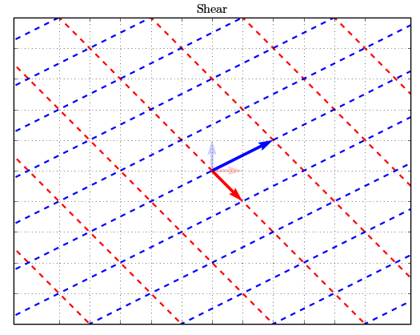
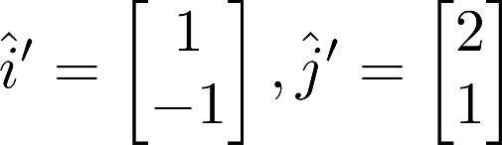
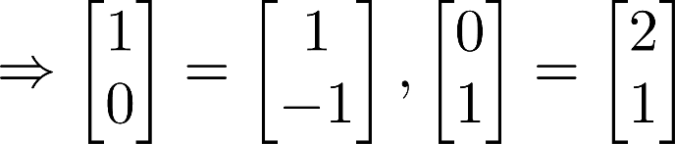

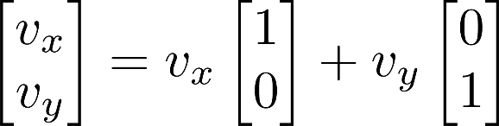

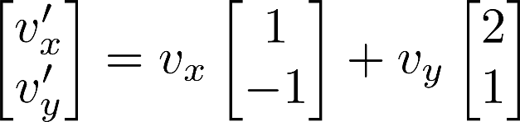
Linear Transformations (2)
Consider the transformation
Consider another vector
  Old basis:
  New basis:
    Same coefficients, new basis vectors
This operation is called applying the linear transformation
  Note how applying a linear transformation and change of basis are the same

Slide 19
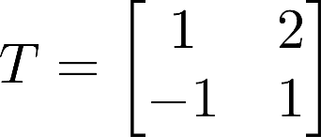

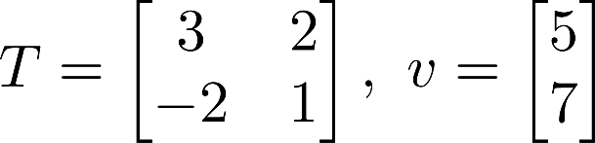
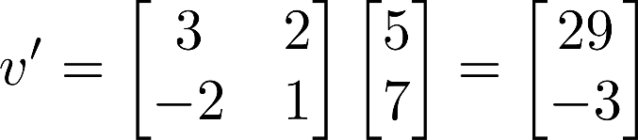
Transformation Matrices
Consider the same transformation
We applied the linear transformation by taking dot products
  Therefore, we can describe it in another way – using a matrix
  This is called the matrix of the linear transformation
  Its columns denote where the basis vectors go
Now, applying the transformation to a vector is the same as
multiplying the matrix times the original vector (in that order!)
Example:

Slide 20
Multiple Transformations
We can apply many transformations, one right after the other
  Result: composite transformation
  We do this by multiplying on the left by the matrix of each transformation
  So, matrix multiplication applying many transformations
To visualize transformations, you can use the code in the visualize_transformation.py file
Intuition
  Apply each transformation in order
  After the last one, record where the basis vectors land
  The new matrix is the matrix of the composite transformation
We can either apply all transformations one by one or just the resulting transformation
  Note that the second is much, much faster; and gives the same result
This is especially useful in computer graphics

Slide 21
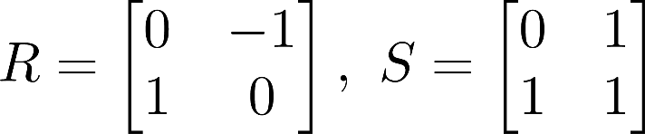
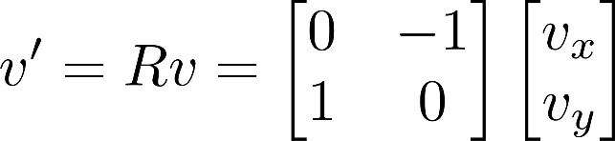
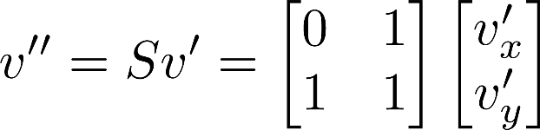
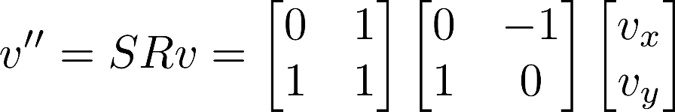
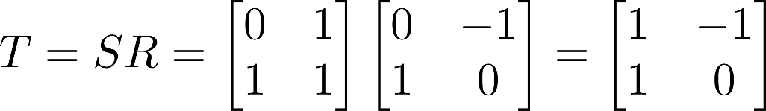
Multiple Transformations (2)
Example: rotation, then shearing
Apply rotation to a vector
Apply shear to the resulting vector
This is the same as
The new transformation matrix is

Slide 22
Determinant
A linear transformation stretches space
  Since lines remain parallel and equidistant, space is stretched equally, no matter
  where we look
  A characteristic of the space is “the unit area” – a 1x1 square
  The transformation will change this area
Determinant – a measure of how much the unit area changes
  Scalar value
  Defined only for square matrices
  For more than two dimensions, area volume
The determinant of a matrix is denoted
  Written with straight lines
  There are “easy” computational rules for 2D and 3D matrices
  Generally, the determinant is given by a formula
The determinant has very useful properties
  Especially

Slide 23
Linear Systems
… again

Slide 24
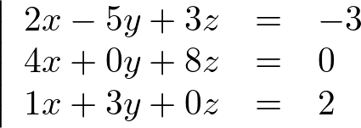
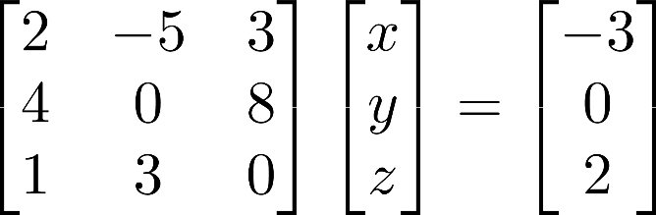
Linear Systems in Matrix Form
Consider the linear system
Unknown variables
We can represent this as a matrix equation
  Or more generally,
  Looks like a linear equation “on steroids”
Transformation perspective
  The matrix specifies a transformation
  This transformation was applied to to get
  Can we find the inverse transformation?

Slide 25


Inverse Matrix
Consider a general, “good” transformation
  We’ll talk later which transformations are not so good
  The inverse transformation will “bring back” the basis vectors
  E.g. clockwise rotation counterclockwise rotation
The inverse transformation has its own matrix:
If we apply the transformation and the inverse, we’ll get our initial result
  This means, nothing will change
  In math terms,
Let’s now try to apply the inverse transformation to our linear system
  Note that this means multiplying on the left

Slide 26
Solving the Linear System
So, to find the unknown vector , we need to find
the inverse matrix of – the matrix of the linear system
  How?
  There are many methods, the most popular of which is called
  Gaussian elimination (or Gauss – Jordan method)
  We’ll see this in the exercises
Basic idea:
  Apply some transformation to get from to
  Apply the same transformation to
  What we get is the inverse matrix
Uses: a lot
  Makes solving linear systems very fast and robust
  Allows us to solve multiple linear systems with the same coefficients and different
  “free terms”

Slide 27
How About “Bad” Matrices?
If the determinant of the matrix is zero, every element is mapped
into a lower-dimensional space
  2D case: every possible point in the 2D space is mapped onto
  a single vector
    We can use the visualization to confirm this
    We can also use our intuition: when is the area equal to zero?
  Another viewpoint: linearly dependent rows
Consequently, there are many points mapped on the same point
  Consider projection as an example
No "reversible" function maps many inputs to one output
  The matrix, therefore, is non-invertible
  does not exist!
However, solutions to the matrix can sometimes exist
  We found one such solution in the first lecture
  We’ll talk about this in more detail in the exercises

Slide 28
Summary
Vectors – geometric and algebraic perspective
  Operations
Matrices
  Definition, properties, operations
Linear transformations
Linear systems

